Slide 1
Distributed sorting
Team White

Slide 2
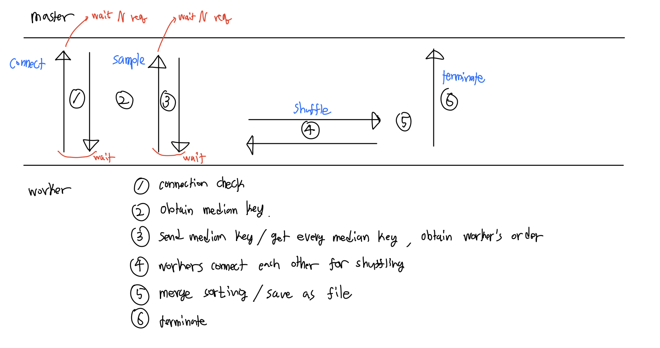
Overall Design

Slide 3
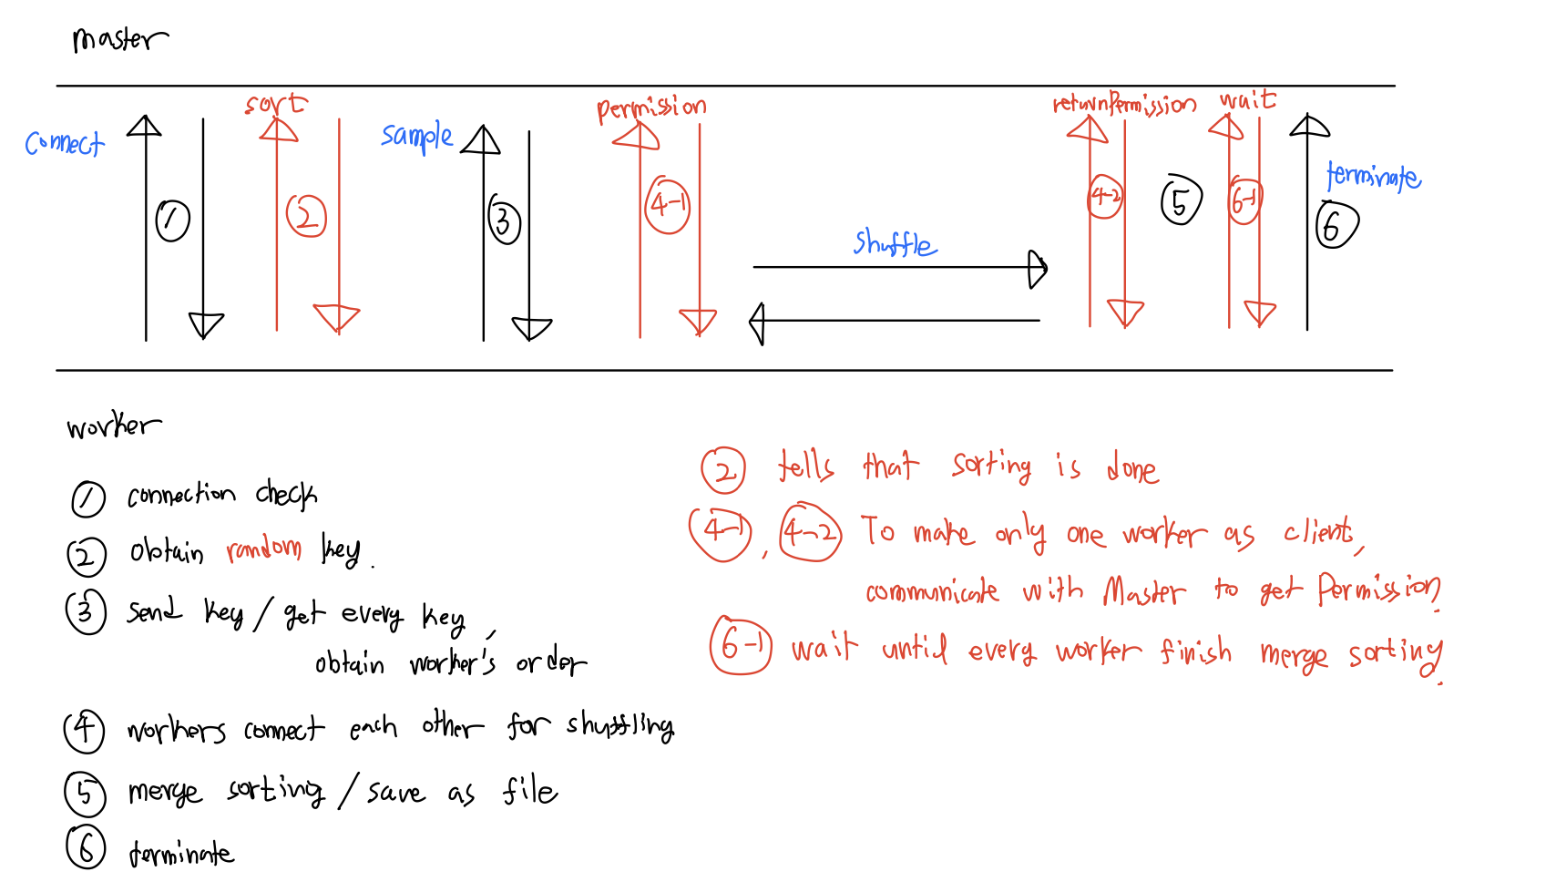
Design – changed

Slide 4
Design – specific
Sort
Use scala’s internal method ‘sort’
Sample
Obtaining key is KEY POINT
At first, we used median key.
We changed into random key in the range to avoid centralized issue

Slide 5
Design – specific
Shuffle
At first, we tried a asynchronized shuffling.
We get into some trouble, so we changed synchronized shuffling.
To implement synchronized shuffling, we add more connection.
Merge
We use K-way merge algorithm as baseline algorithm.
We recursively implement merge algorithm.

Slide 6
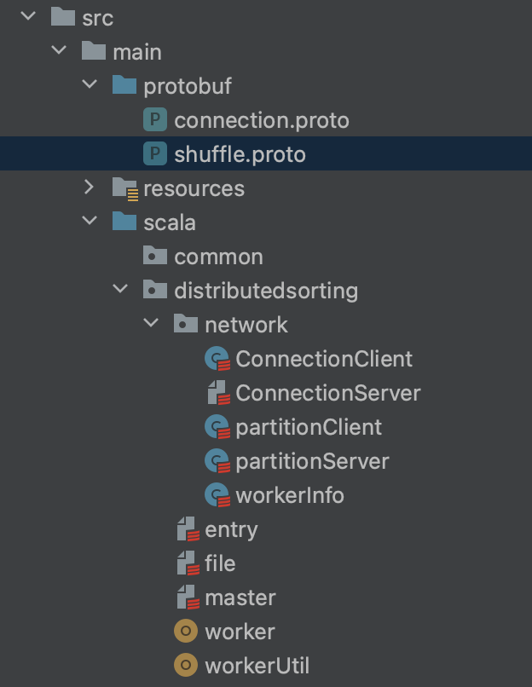
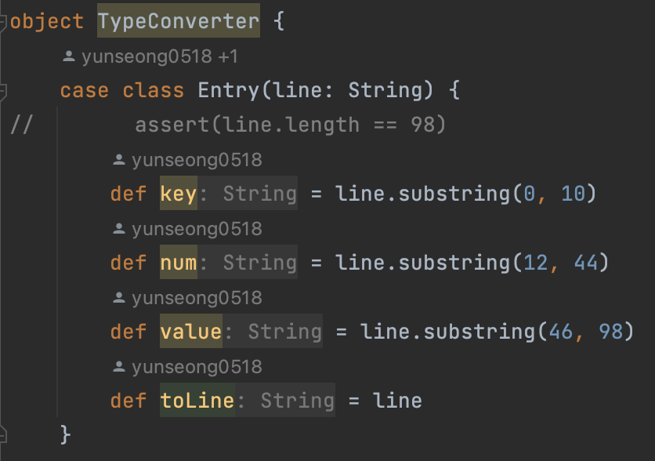
Design – code

Slide 7
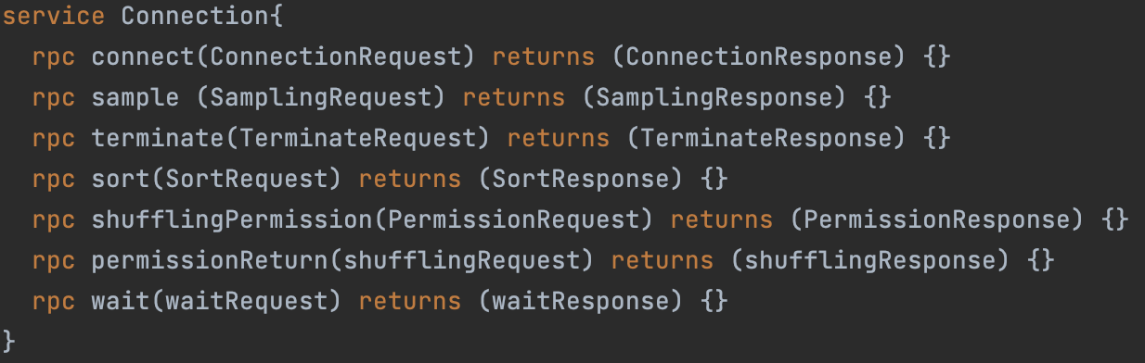
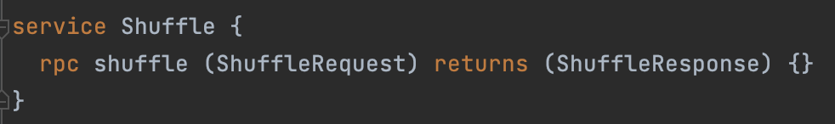
Design – code

Slide 8
Role
DongHa Kim – Leader, bridge, subdeveloper
SeongJin Choi – gRPC developer
YunSeong Moon – Function developer

Slide 9
Milestones
Create a project blueprint – (Kim)
Initialize project, versioning – (Kim)
Split file into several files – (Moon)
Create input files using gensort – (Moon)
Create test cases – (Moon)
Setting a logger – (Kim)
Making protobuf file – (Kim, Choi)
Implement file utility function – (Moon)
Implement type, type converter between string and block entry - (Moon)
Parsing the input - (Moon)
Connect the master with worker - (Choi)
Read file as block – (Moon)
Sort block – (Moon)
Obtain median key – (Kim)
Obtain worker’s order - (Kim)
Filter data for shuffling – (Kim)
Merge Sort & save output as file – (Moon)
Combine all together, make program works,
debug – (Kim, Choi)

Slide 10
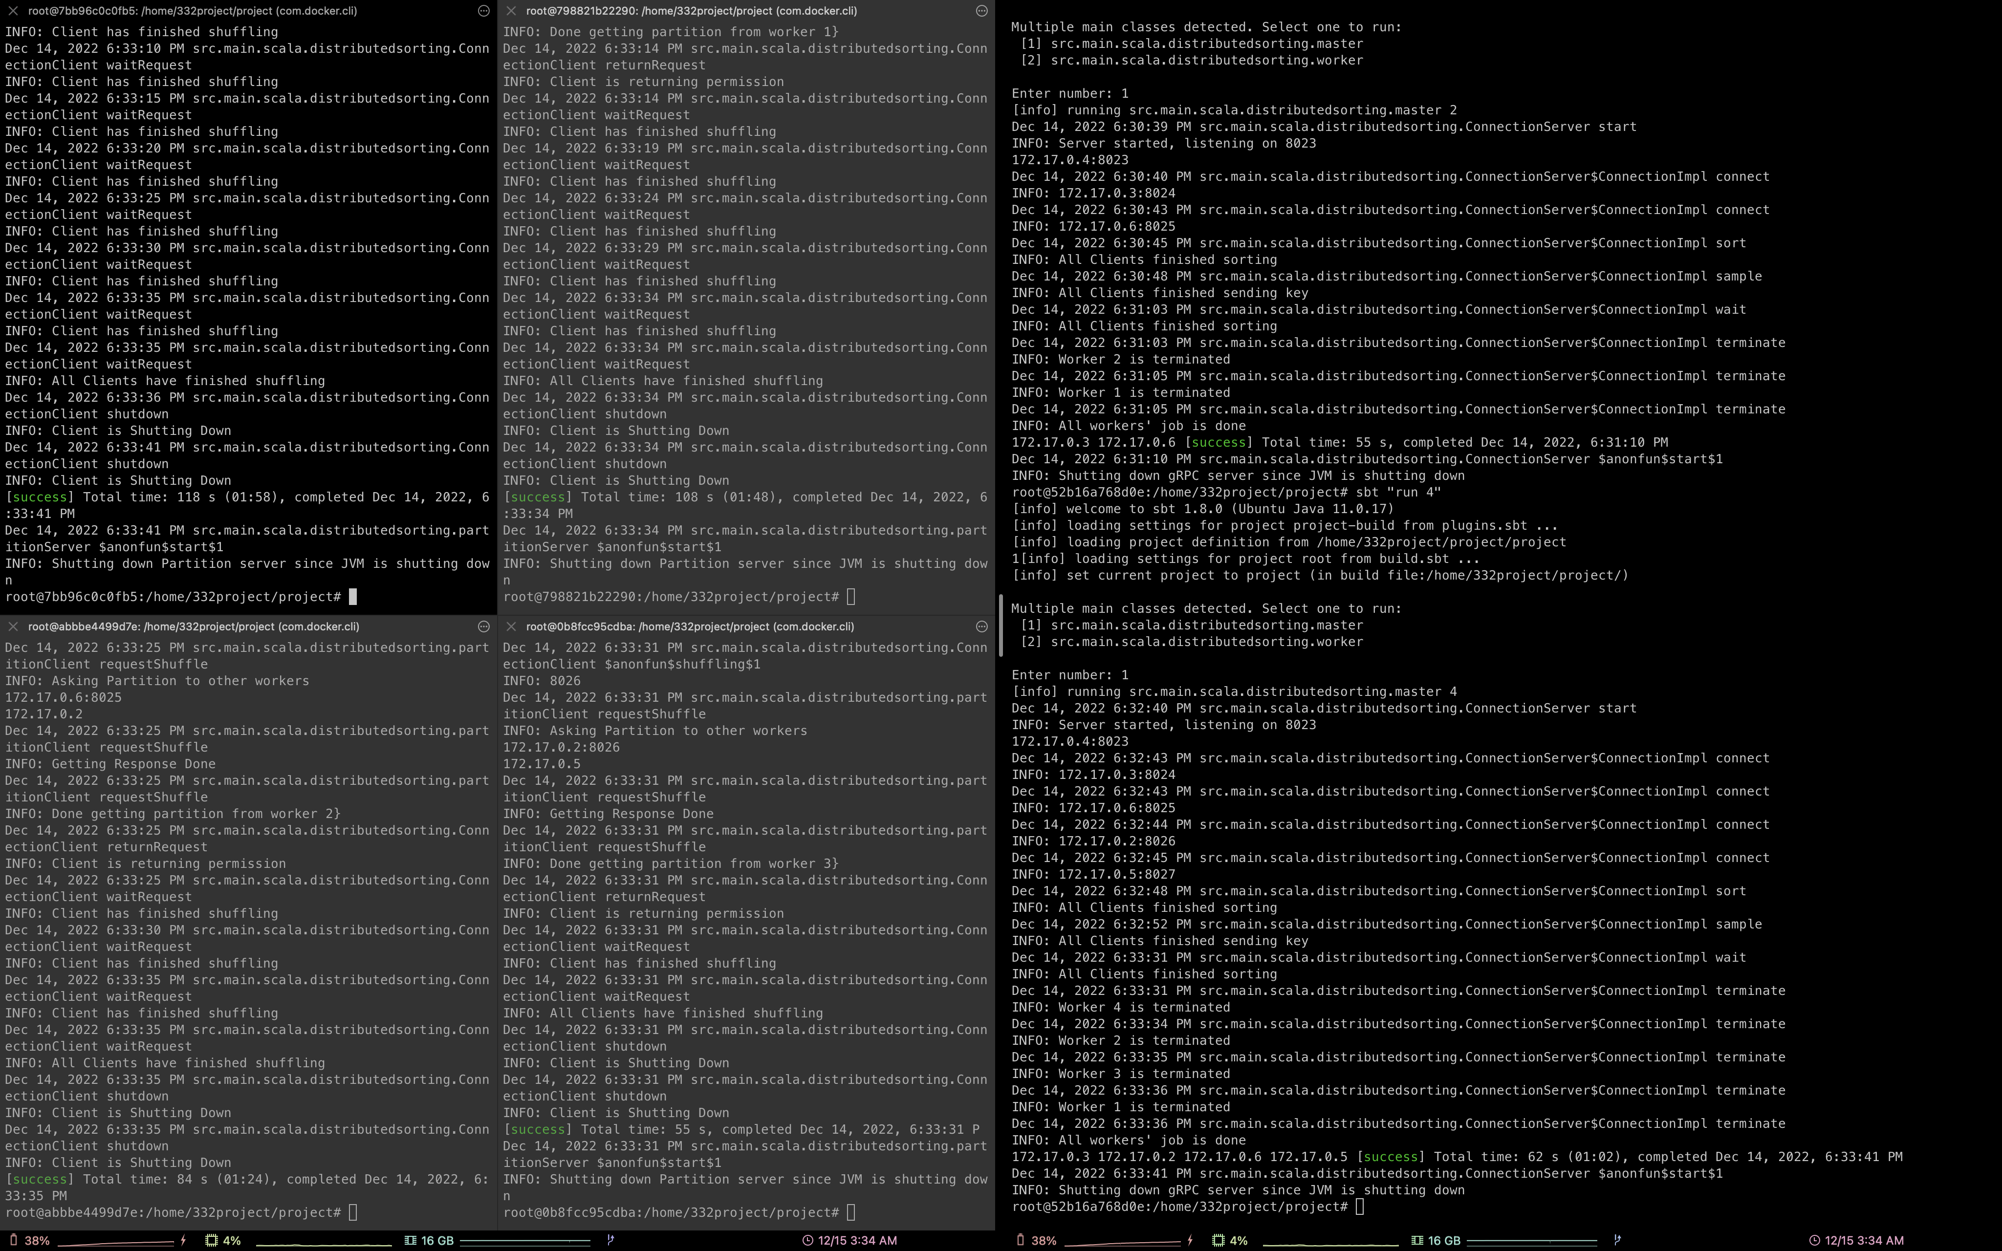
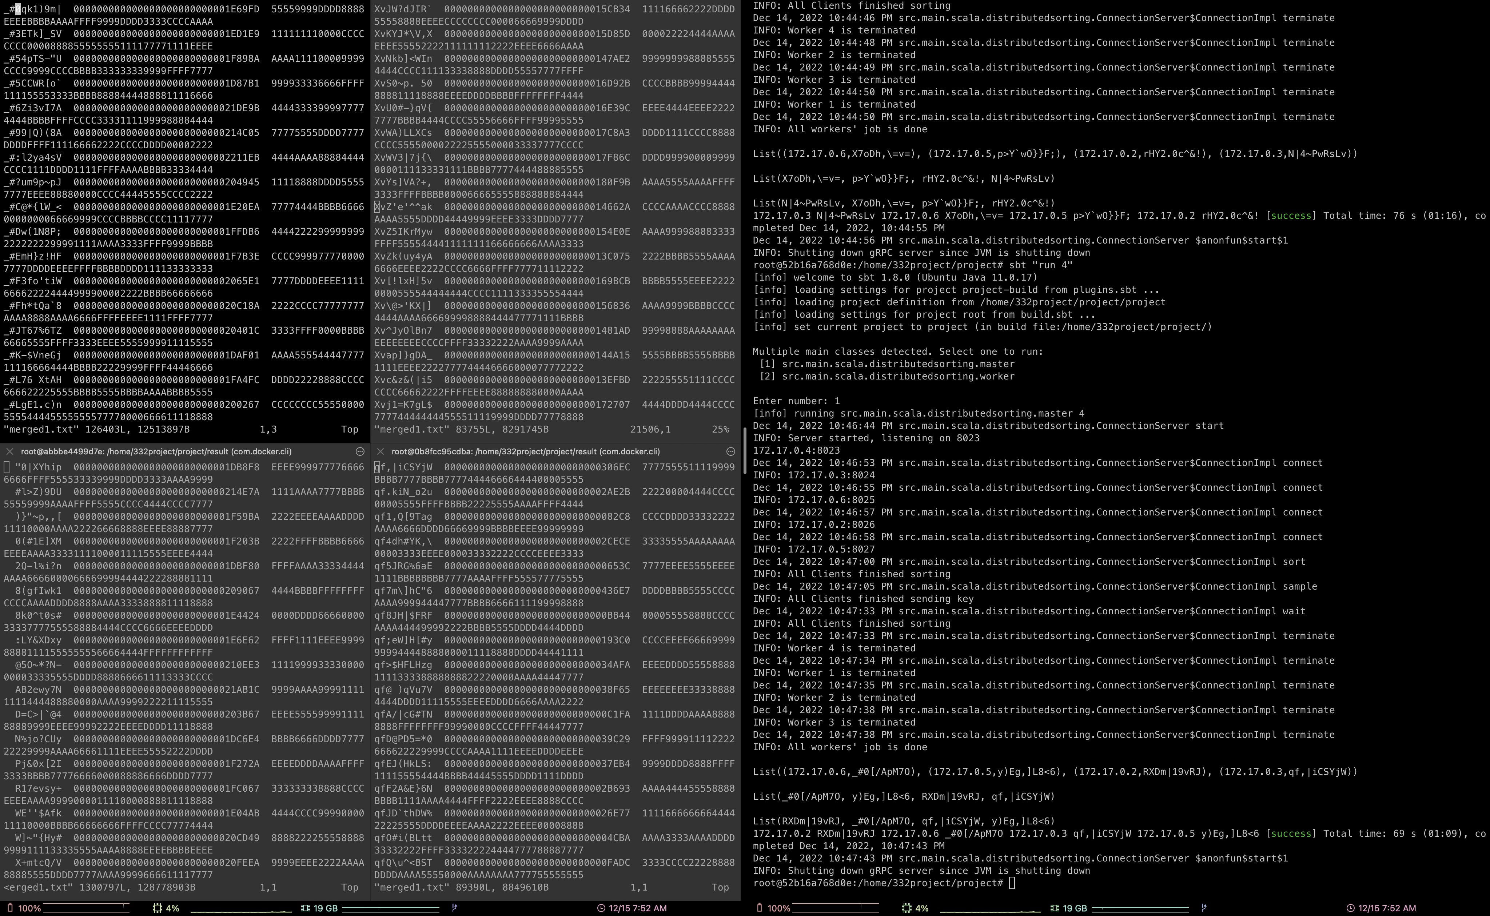
experiments
4 workers, 1 master
Each worker has two 32MB block as unsorted
Fail to make correct result
data losing ii) order miss
Take 50 seconds in our local setting

Slide 11
Discussion
Obtaing key
Concurrent sorting
Data losing – in merge sorting
Obtaining order – since using key list, not using sorted key list
Initial distributing from Master to Worker
Simplifying Connection
Considering invalid cases

Slide 12
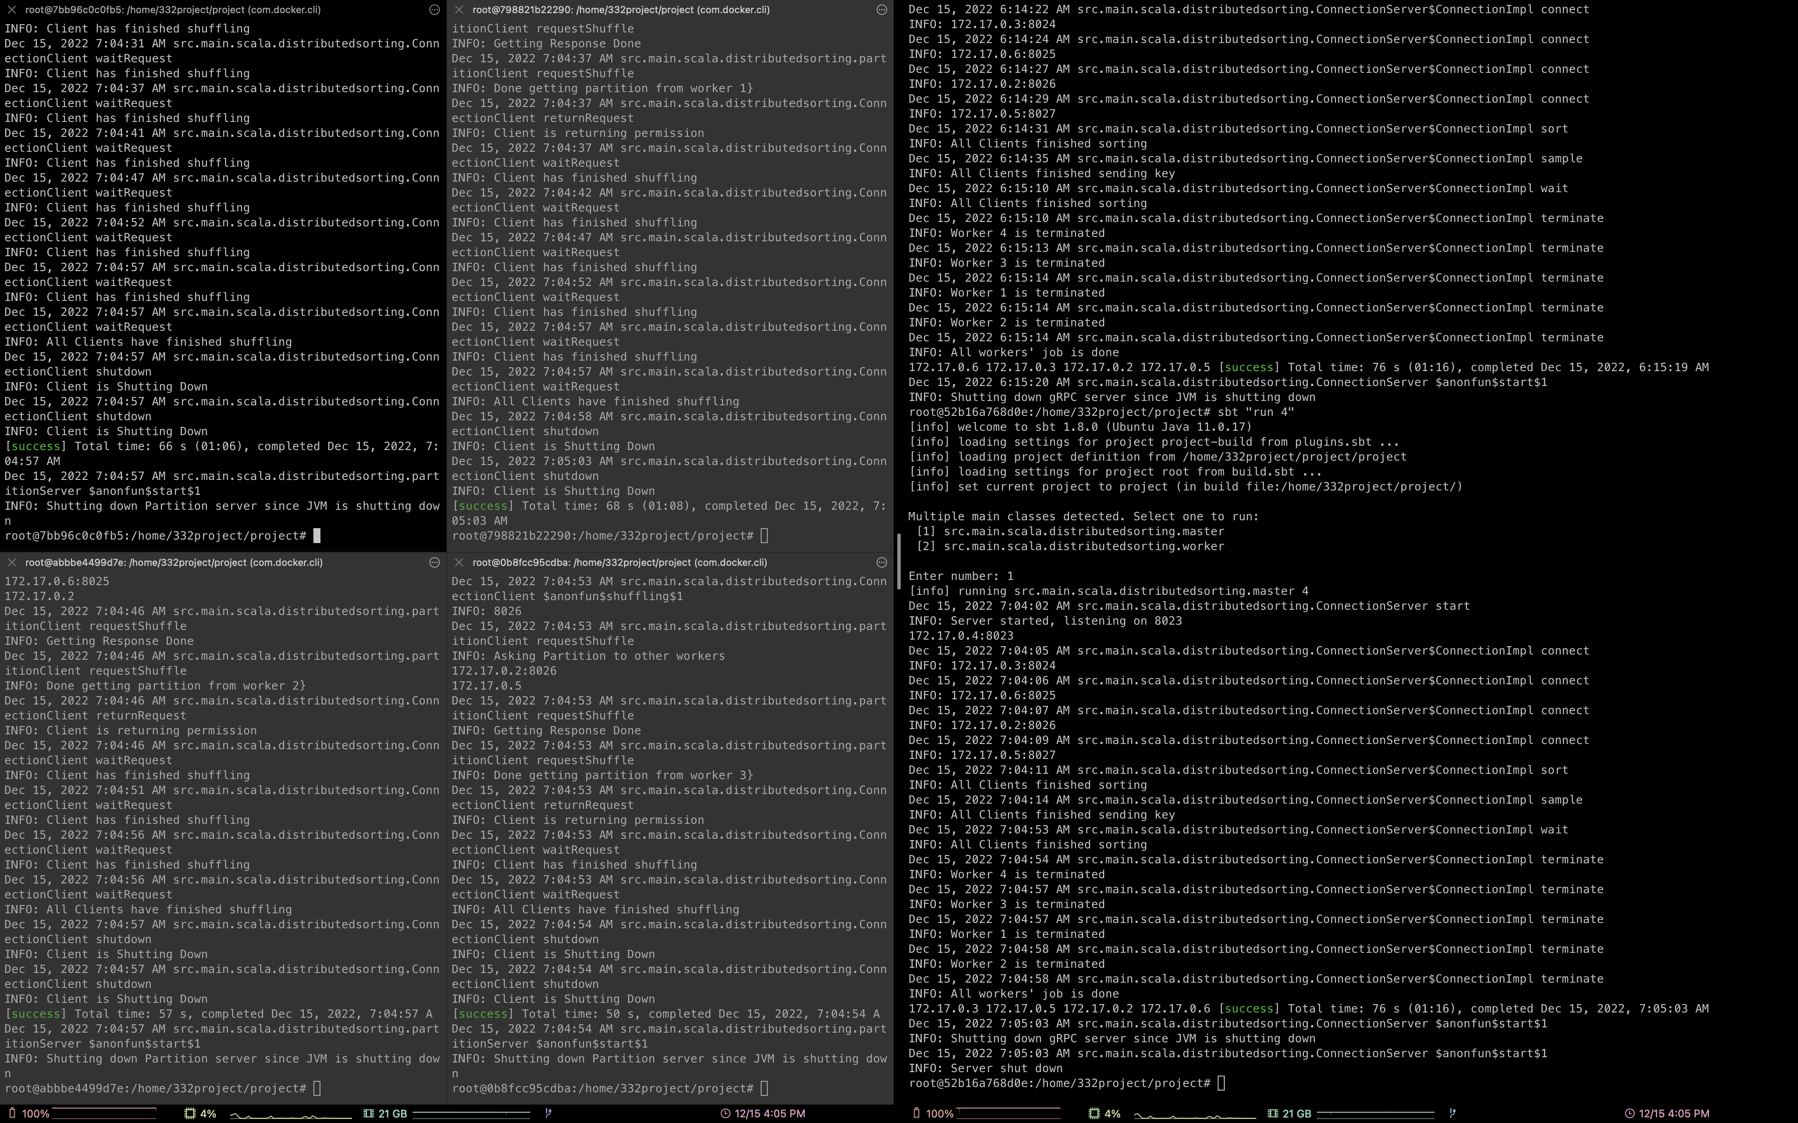
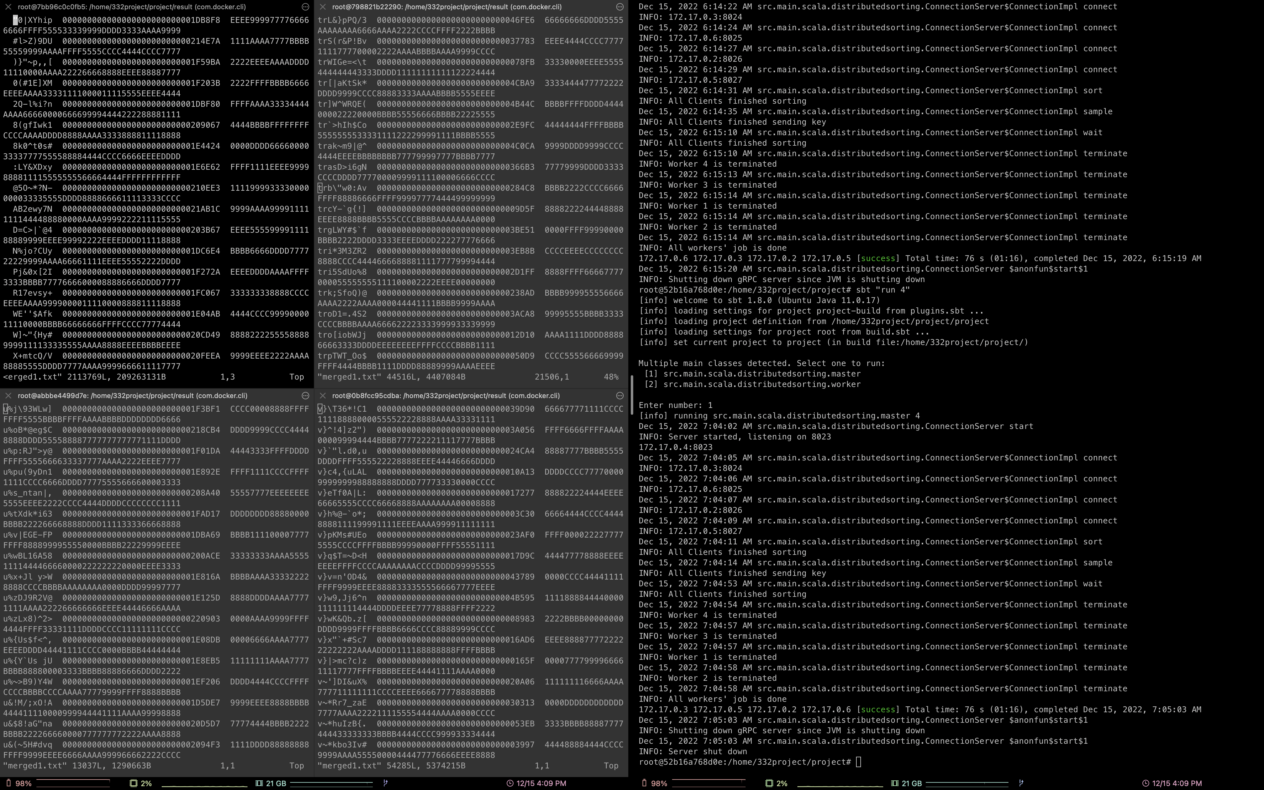
New experiment
Succeed to make correct order, but data losing still happens.

Slide 13
What we learn
Exact blueprint is important
Implementing before Optimizing
Unexpectable schedule
Understanding comes after Implementing

Slide 14
End
Thank you

